Slide 1
INSTALLATION AND SETUP

Slide 2
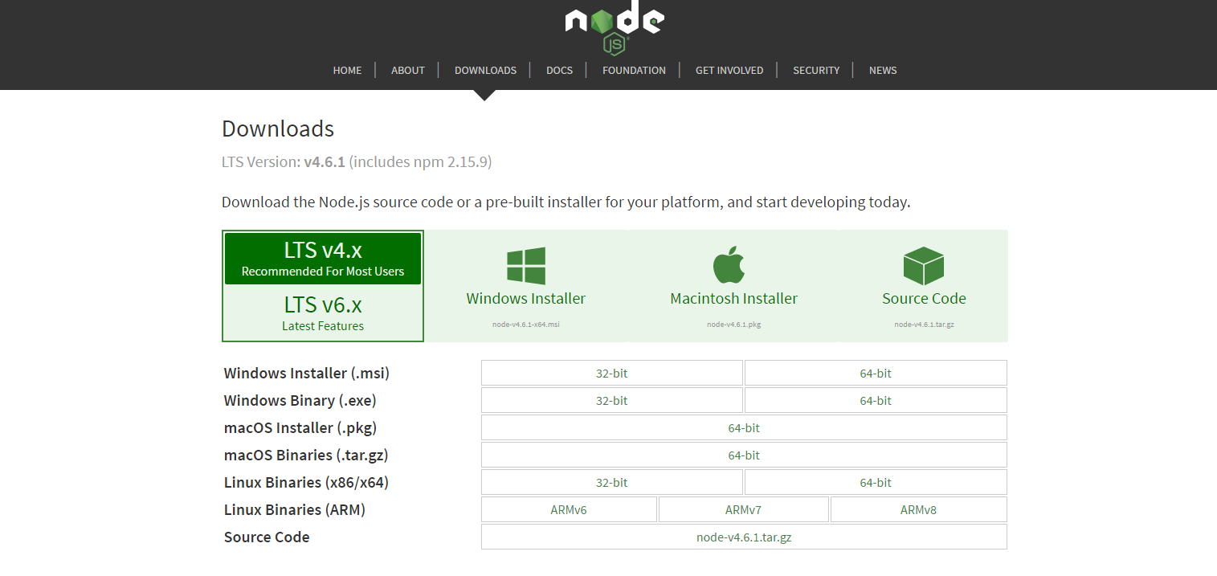
INSTALLATION

Slide 3
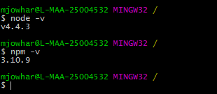
https://nodejs.org/en/download/
Use always LTS version of node.
Install python 2.7
Install gcc (if linux) or Install VCBuild.exe (Microsoft Build Tools, if Windows)
Node.JS native Addon - https://github.com/nodejs/node-gyp

Slide 4
Running node programs
node filename.js
node is the command line program to invoke Node.JS Interpreter.
Play with node by writing sample program
Use any of the built in modules in your NodeJS program
Test any of the JavaScript language feature .

Slide 5
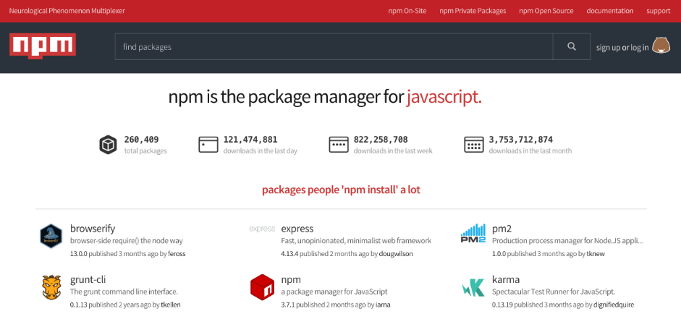
npm - node package manager

Slide 6
npm – Node Package Manager
http://npmjs.com
NPM is the package manager used by Node.js applications
Like Maven for Java, pip for python ,cpan for perl
Easy to reuse the modules from the community
npm is the part of nodejs installation.

Slide 7
Type of packages
local package
created at the local folder where you have node project
<current_folder>\node_modules
global package
created at the user home directory.
C:\Users\mjowhar\AppData\Roaming\npm\node_modules

Slide 8
package.json
Describes a module, usefully documenting the module's name, version number, dependencies
Must be JSON structure.
It must exist if you would like to publish your package via npm
npm init
Contains fields
name , version , description, entry point ,
licence, repository, dependencies, devDependencies ,scripts

Slide 9
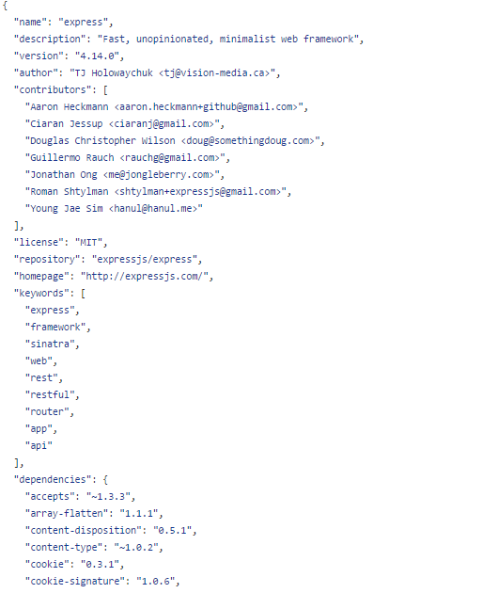
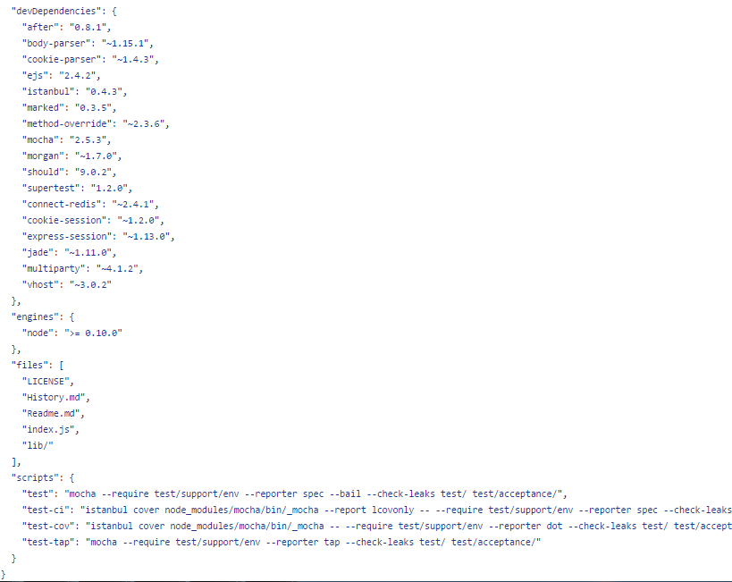
Expressjs – package.json

Slide 10
npm commands
npm install <package_name> <flag>
<flag> --save , --save-dev
<flag> -g
npm uninstall
npm ls
npm cache
npm config list

Slide 11
commands
npm init –yes //double dash
npm config list
npm install uglify-js --global
npm list –g
npm install underscore
npm list
npm uninstall underscore
npm update underscore
npm bluebird –save

